Slide 1
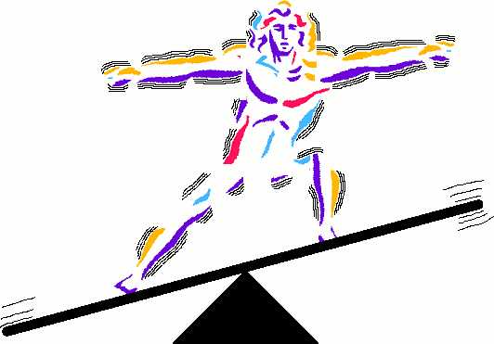
Unit 1, Pt 3
Maintaining Homeostasis

Slide 2
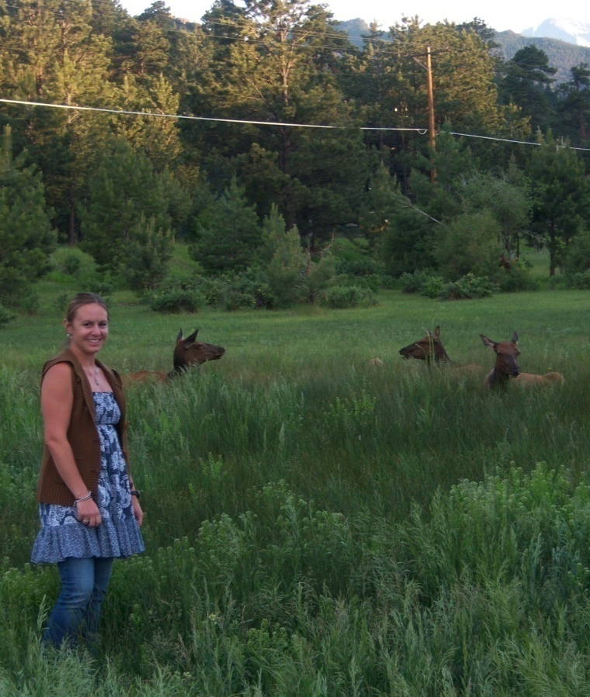
Homeostasis –
Necessary Life Functions
What defines all living organisms?
  Maintain boundaries
  Movement
    Locomotion
    Movement of substances
  Responsiveness
    Ability to sense changes & react
  Digestion
    Break-down & absorption of nutrients

Slide 3
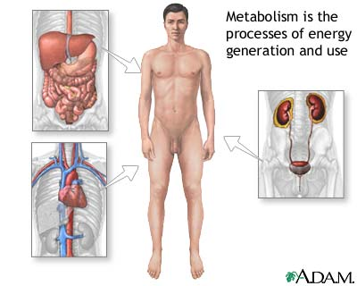
Homeostasis –
Necessary Life Functions
What defines all living organisms?
  Metabolism—chemical reactions within the body
    Produces energy
    Makes body structures
  Excretion
    Eliminates waste from metabolic reactions
  Reproduction
    Produces future generations
  Growth
    Increases cell size & number of cells

Slide 4
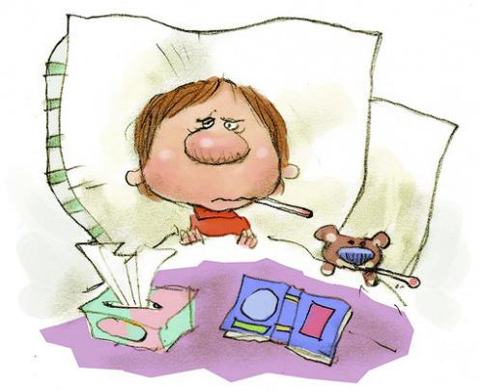


Homeostasis – Survival Needs
Nutrients
  Chemicals for energy and cell building
  Includes carbohydrates, proteins, lipids, vitamins & minerals
Oxygen
  Required for chemical reactions
Water
  60–80% of body weight
  Provides for metabolic reaction
Stable body temperature
Atmospheric pressure
  Must be appropriate

Slide 5
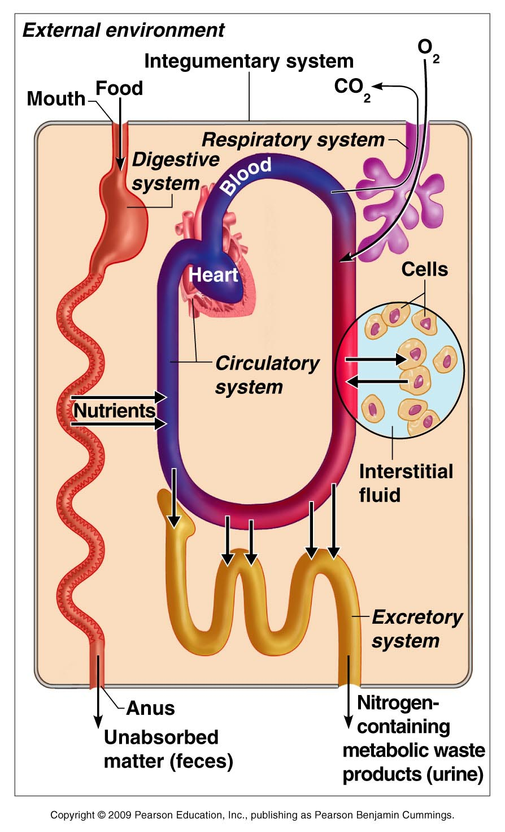
Homeostasis –
Interrelation- ships Among Body Systems

Slide 6
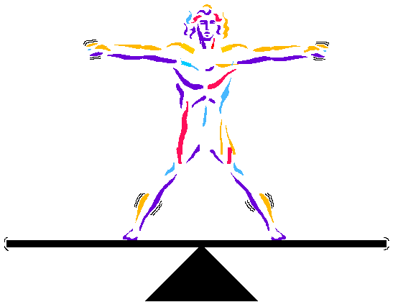
Homeostasis
Homeostasis—maintenance of a stable internal environment
  A dynamic state of equilibrium
Homeostasis is necessary for normal body functioning & to sustain life
Homeostatic imbalance
  A disturbance in homeostasis resulting in disease, illness or death

Slide 7
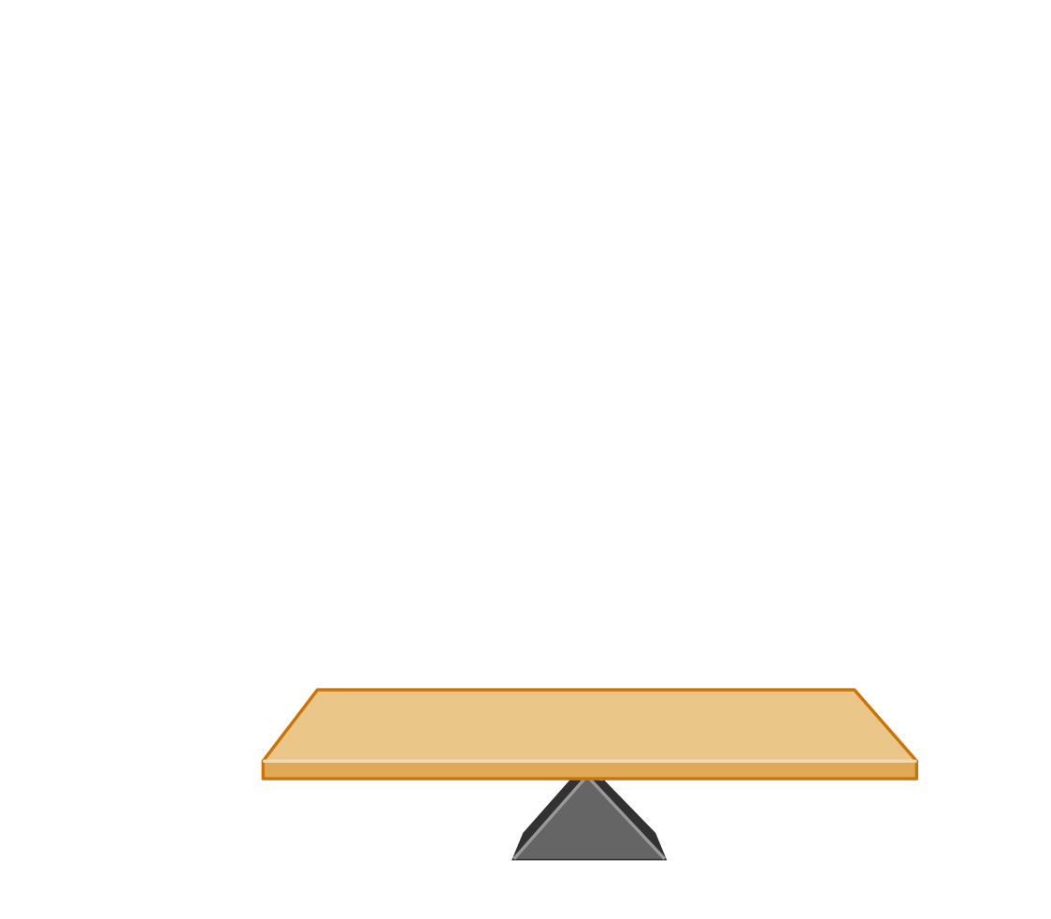
Variable
(in homeostasis)
Figure 1.4, step 1a

Slide 8
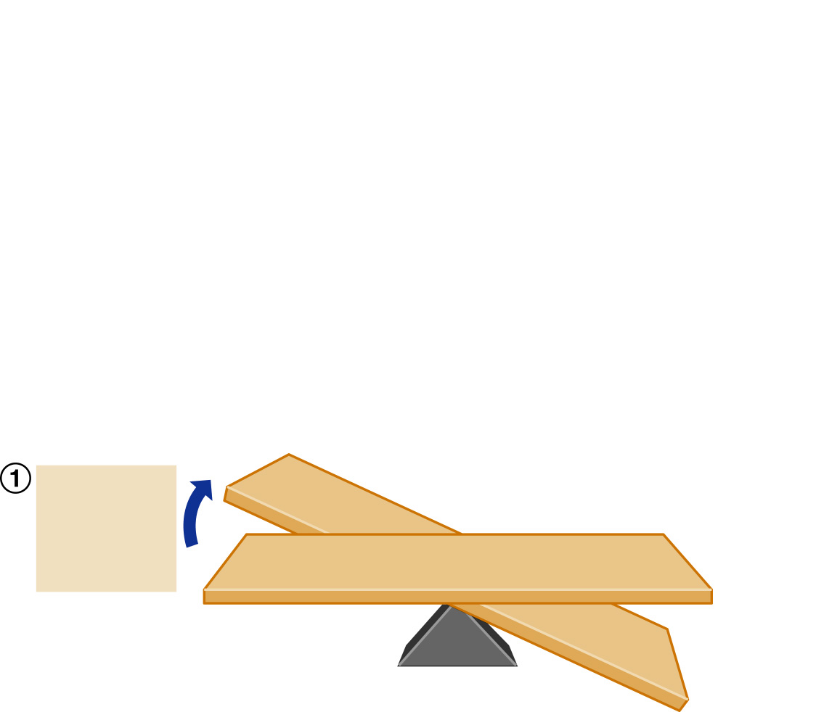
Stimulus:
Produces
change
in variable
Imbalance
Variable
(in homeostasis)
Imbalance
Figure 1.4, step 1b

Slide 9
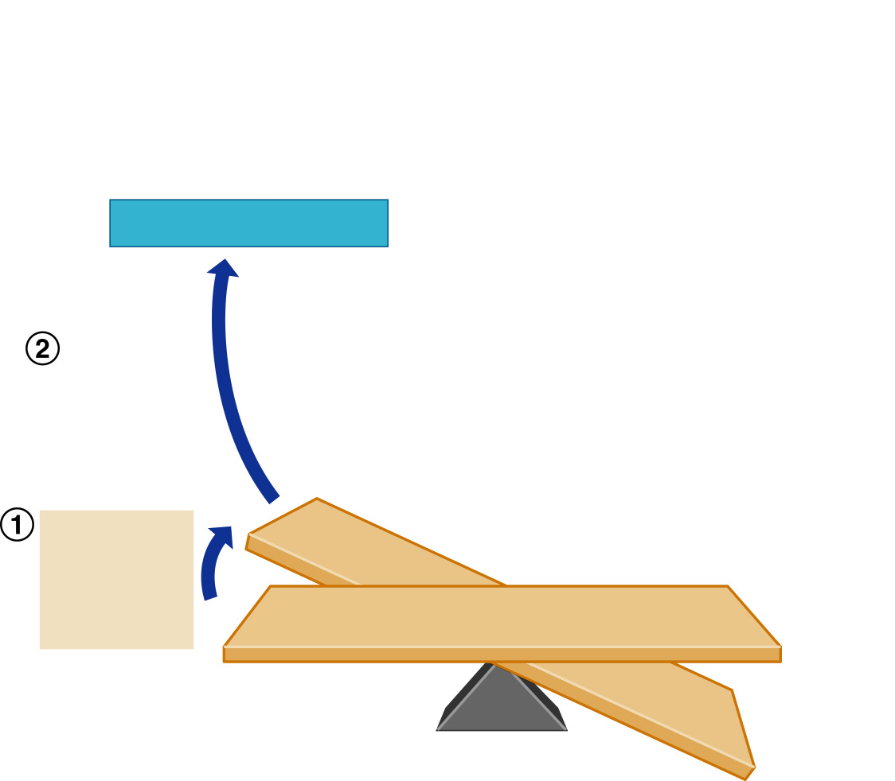
Receptor (sensor)
Change
detected
by receptor
Stimulus:
Produces
change
in variable
Imbalance
Variable
(in homeostasis)
Imbalance
Figure 1.4, step 2

Slide 10
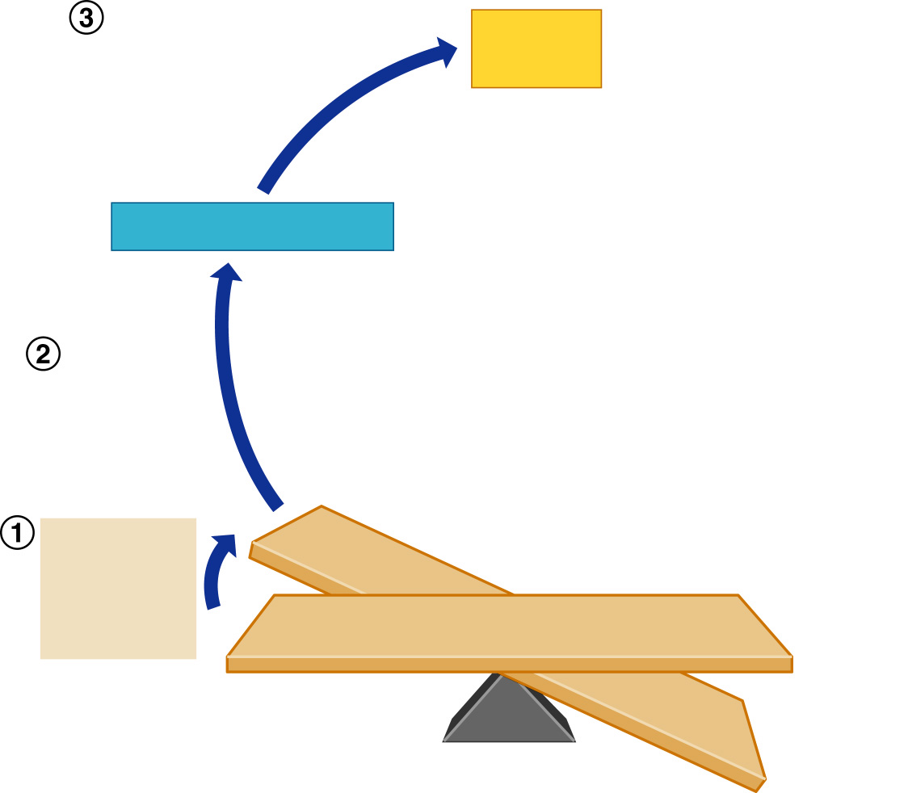
Input:
Information
sent along
afferent
(“a” before “e”) pathway to
Control
center
Receptor (sensor)
Change
detected
by receptor
Stimulus:
Produces
change
in variable
Imbalance
Variable
(in homeostasis)
Imbalance
Figure 1.4, step 3

Slide 11
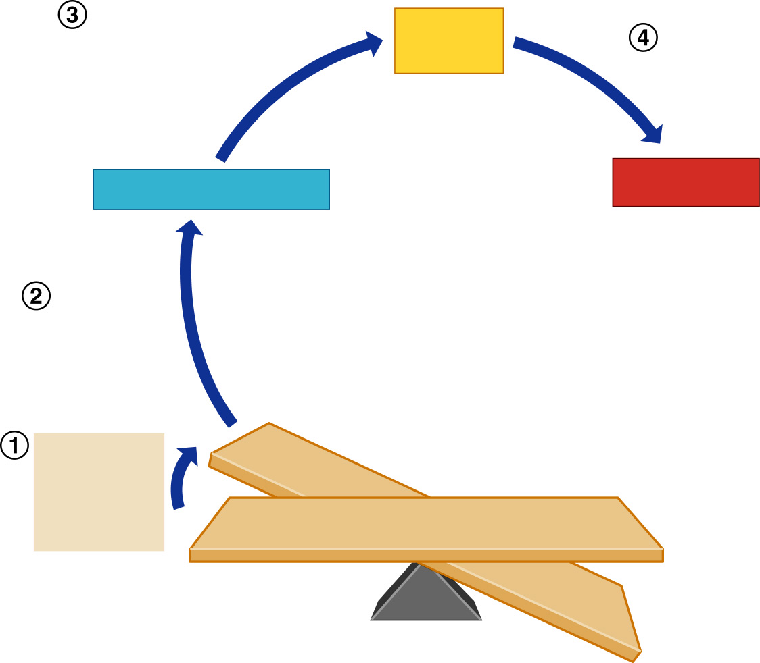
Input:
Information
sent along
afferent
pathway to
Output:
Information sent
along efferent
(“a” before “e”) pathway to activate
Control
center
Receptor (sensor)
Effector
Change
detected
by receptor
Stimulus:
Produces
change
in variable
Imbalance
Variable
(in homeostasis)
Imbalance
Figure 1.4, step 4

Slide 12
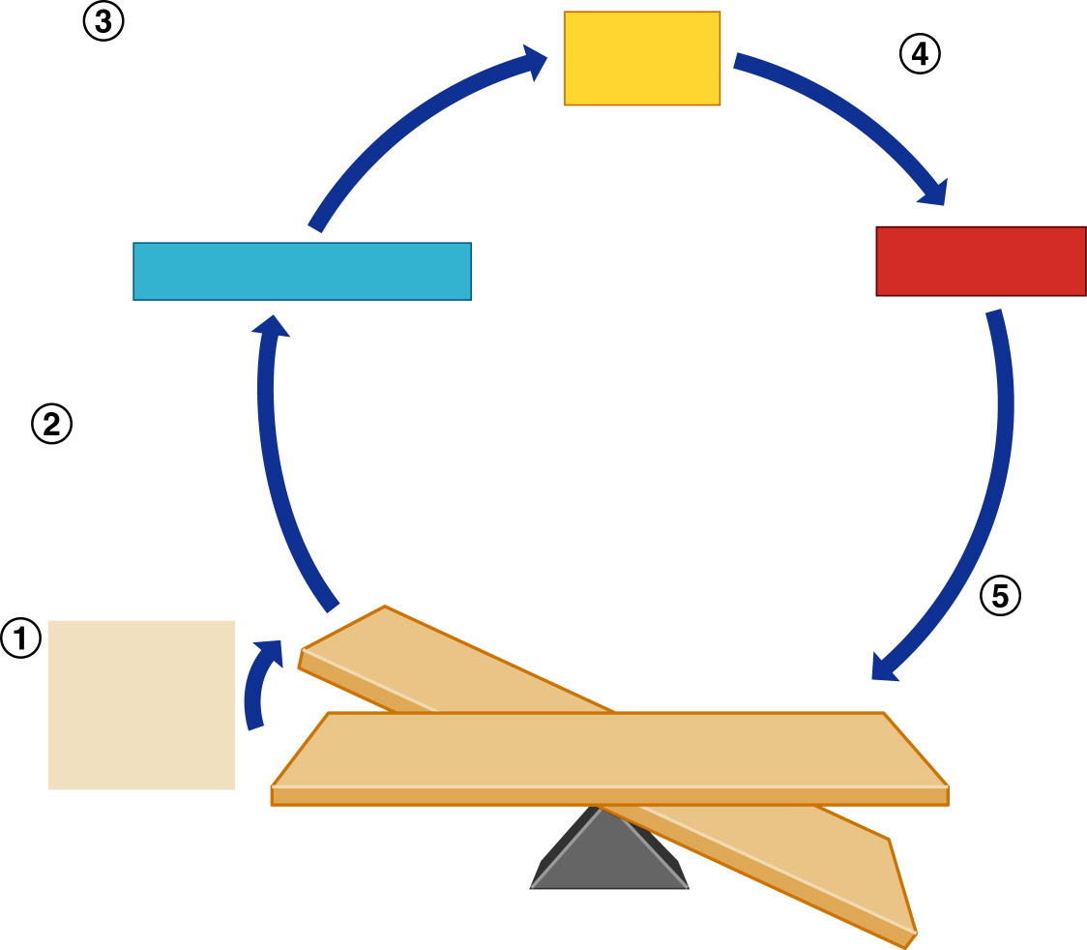
Input:
Information
sent along
afferent
pathway to
Control
center
Output:
Information sent
along efferent
pathway to activate
Receptor (sensor)
Effector
Change
detected
by receptor
Stimulus:
Produces
change
in variable
Response of
effector feeds
back to
influence
magnitude of
stimulus and
returns variable
to homeostasis
Imbalance
Variable
(in homeostasis)
Imbalance
Figure 1.4, step 5

Slide 13
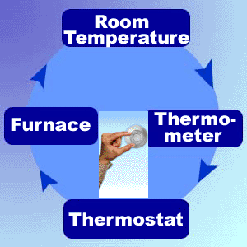
Maintaining Homeostasis
The body communicates through neural (Nervous System) & hormonal (Endocrine System) control systems
  Receptor
    Responds to changes in the environment (stimuli)
    Sends information to control center
  Control center
    Determines set point (threshold)
    Analyzes information
    Determines appropriate response
  Effector
    Provides a means for response to the stimulus
Effector
Receptor
Control Center

Slide 14
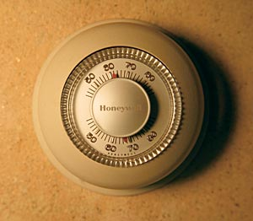
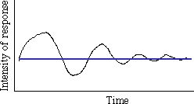
Feedback Mechanisms
Negative feedback (ALWAYS A GOOD THING!!! ☺)
  Includes most homeostatic control mechanisms
  Shuts off the original stimulus, or reduces its intensity
  Works like a household thermostat
    Increase in temperature outside = increase in temperature inside
    Thermostat senses increasing temperature
    Thermostat turns fan/air conditioner on
    Inside temperature decreases
    Regulation of body temperature - thermoregulation
Graph showing example of negative feedback

Slide 15
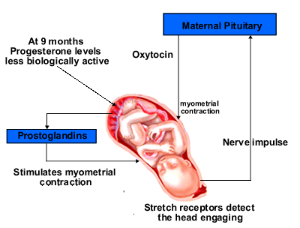
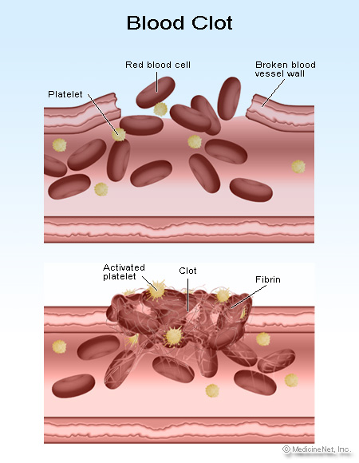
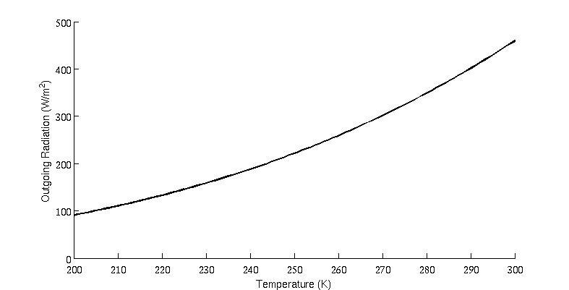
Feedback Mechanisms
Positive feedback
  Increases the original stimulus to push the variable farther
  In the body, THIS IS NOT A GOOD THING in fact it is a sign of something VERY BAD except…)
  In the body, this only occurs in blood clotting & during birth (labor contractions)
Graph showing example of positive feedback

Slide 16
Feedback Mechanisms
???s on Positive or Negative Feedback Mechanisms?
???s on Homeostasis?
Positive feedback
    Blood clotting:
      Injured tissue releases signal chemicals that activate platelets in blood
      Activated platelets release chemicals to activate more platelets
      Causes rapid cascade & formation of blood clot
    Labor contractions:
      When a contraction occurs, the hormone oxytocin is released into the body
      Oxytocin stimulates further contractions
      Contractions increase in amplitude & frequency

